Slide 1
Ethos, Pathos, or Logos?
What appeal are advertisers using to get you to buy their product?

Slide 2
Objective:
As you view each advertisement that comes up on the screen, decide if it’s appealing to your sense of ethos, pathos, or logos.
Write/log your answers on the document handed out to you as the slide show continues.

Slide 3
ETHOS, PATHOS, and LOGOS
AS YOU ANALYZE THE ADVERTISMENTS:
Ethos: Is it Ethical?
Pathos: Does it make you feel a strong emotion?
Logos: Does it make you use your sense of reason?

Slide 4
Logos
Logos: Logic
To make the audience think about what is presented to it
Statistics, facts, authorities, etc…
Very straightforward, and not “fluff”. It has a very scientific, factual approach.

Slide 5
Ethos
Ethos: Ethics
To make the audience decide right or wrong about what is being presented to it
Political issues, national beliefs, religious issues, etc…
Typically has contrasting colors symbolizing the difference between good and evil.

Slide 6
Pathos
Pathos: Emotion
To make the audience feel something about what is presented to it
Children, animals, illness, memories, etc…
“Tugs at your heart strings”

Slide 7
Can some advertisements have more than one appeal?
Yes! The more appeals used in an ad the more likely the consumer is to connect with it.
For the case of this lesson or power point, pick the MOST emphasized appeal used in each ad to write onto your sheet.

Slide 8
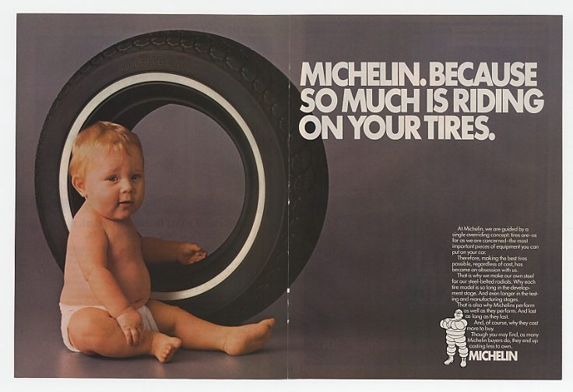
Ethos, Pathos, or Logos?

Slide 10
Ethos, Pathos, or Logos?

Slide 11
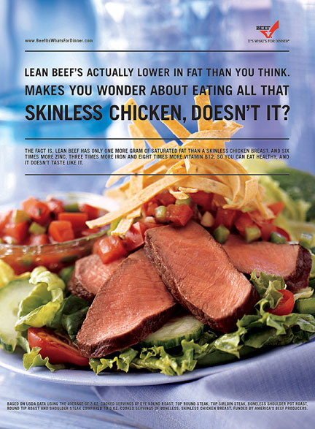
Ethos, Pathos, or Logos?

Slide 12
Ethos, Pathos, or Logos?

Slide 13
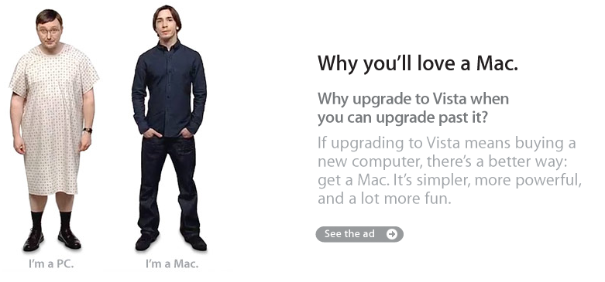
Ethos, Pathos, or Logos?

Slide 15
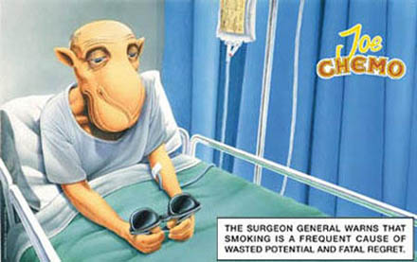
Ethos, Pathos, or Logos?

Slide 16
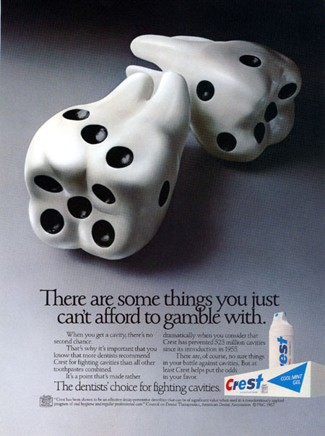
Ethos, Pathos, Logos?

Slide 17
Ethos, Pathos, or Logos?

Slide 18
Ethos, Pathos, or Logos?

Slide 19
Other Examples
Great Debaters
Shark Tank

Slide 20
The End!
Your homework is to bring in to class a print advertisement (school appropriate…when in doubt don’t do it).

Slide 21
Ad Analysis
Leave your ad on your desk.
You and one other person will analysis 10 ads.
Complete the following for each:
The # & Name of “product” being advertised
A: Intended Audience
B: Spoke person (if there is one)
C: Purpose of advertisement
D: Type of persuasive appeals-briefly explain

Slide 22
FOR EXAMPLE: Ad Analysis
#1: Michelin Tires
Little Baby
Don’t skimp on the important stuff, we need good tires our families depend on it.
Pathos (little babies are cute and we want them to live)

Slide 23
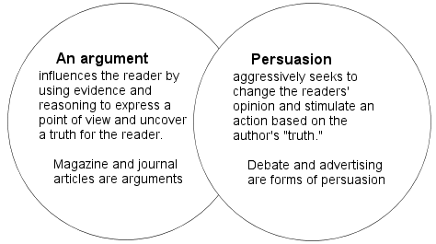
Argument vs. Persuasion-What’s the difference?

Slide 24
Appeals used with Argumentation
Logos
Ethos

Slide 25
Appeals used with Persuasion
Logos
Ethos
Pathos

Slide 26
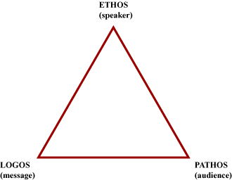
Rhetorical Triangle

